Slide 1
Perspectives on Interdisciplinary SSAH Policy-Making
Rick Szostak
University of Alberta
College of Europe
Stronger Together Conference, Tervuren, BE, May 7, 2024

Slide 2
Integrating across SSAH
Will better transcend scholarly biases (every discipline has favoured theories, methods, and phenomena to study)
Will better identify side effects
Will better capture the complexity of policy challenges
Will better prepare us for instability and unknown unknowns
Will first evaluate disciplinary insights in a way that complements disciplinary evaluation, and then integrate the best ideas

Slide 3
A Further Kind of Integration
We should then enhance ties between integrative scholars and policy-makers.
These should interact regularly so that academics know the challenges being faced, and can address these.
So we need a sizeable body of integrative scholars in regular contact with policy-makers
See https://i2s.anu.edu.au/

Slide 4
The skills of integrative scholars
May also be useful in mediating among competing interests (and identifying their core interests and beliefs)
May also be useful in communicating policy proposals to diverse audiences
Are also invaluable when policies are later evaluated

Slide 5
Interdisciplinarity and Instability
We may not often need to understand how pandemics or wars affect economies, but it is sometimes really important.
More generally all disciplines tend to focus on the forces generating stability within subsystems: economic stability, cultural stability etc.
They all recognize instability but tend to treat sources of instability as exogenous.
Economics largely focuses on equilibria or constrained cycles. Even when we discuss growth we often theorize a very stable kind of growth.
Interdisciplinary analyses often try to grapple with change and instability.
We need to understand both stability and instability.
“Stability, Instability, and Interdisciplinarity” Issues in Interdisciplinary Studies.35, 65-87, 2017.

Slide 6
Historical Transformations
ALL historical transformations involves cross-disciplinary linkages. That is, economic transformations do not just have economic causes or effects.
Recognizing this, we should not expect the Great Depression to have been an entirely economic event. [There are very good reasons to blame much of it on the time path of technological innovation]
Looking forward we will be much better able to cope with the future if we explore cross-disciplinary linkages.
“Can examining cross-disciplinary interactions illuminate unknown unknowns? Integration and Implementation Sciences, January 2021 (blog post) https://i2insights.org/2021/01/05/cross-disciplinarity-illuminates-unknown-unknowns/comment-page-1/#comment-30503 This was re-blogged in July 2023.

Slide 7
Integration (Requires creativity)
Strategies to achieve integration:
  Redefinition: Meanings of concepts are clarified.
  Theory extension: A theory is broadened in scope to envelop the concerns of other theories.
  Organization: Seemingly unrelated concepts are placed in some relationship or classification.
  Transformation: Opposing insights are placed on a continuum.

Slide 8
Interdisciplinary Evaluation
It is important to appreciate that interdisciplinary evaluation complements disciplinary evaluation.
Disciplinary referees and editors will ask whether disciplinary theory and method are properly applied.
Interdisciplinary analysis asks what alternative theories and methods might have found, whether disciplinary perspective guides results, and why results might differ across disciplines. [Students can find this empowering.]

Slide 9
Disciplines
Establish a mutually supportive set of theories, methods, phenomena to study, and epistemological beliefs. This evolves slowly through time, and is reflected in a set of guidelines for hiring, promotion, publication.
The rise of behavioral and experimental economics shows how evolution can involve a new coherent set.

Slide 10
Synergy between Specialized and Integrative Research
Integrative research integrates across phenomena, theories, and methods, drawing upon specialized research
Can then inform specialized researchers of the benefits of alternative phenomena, theories, and methods
If we want a more coherent social science, we will need something more than just strong disciplines.

Slide 11
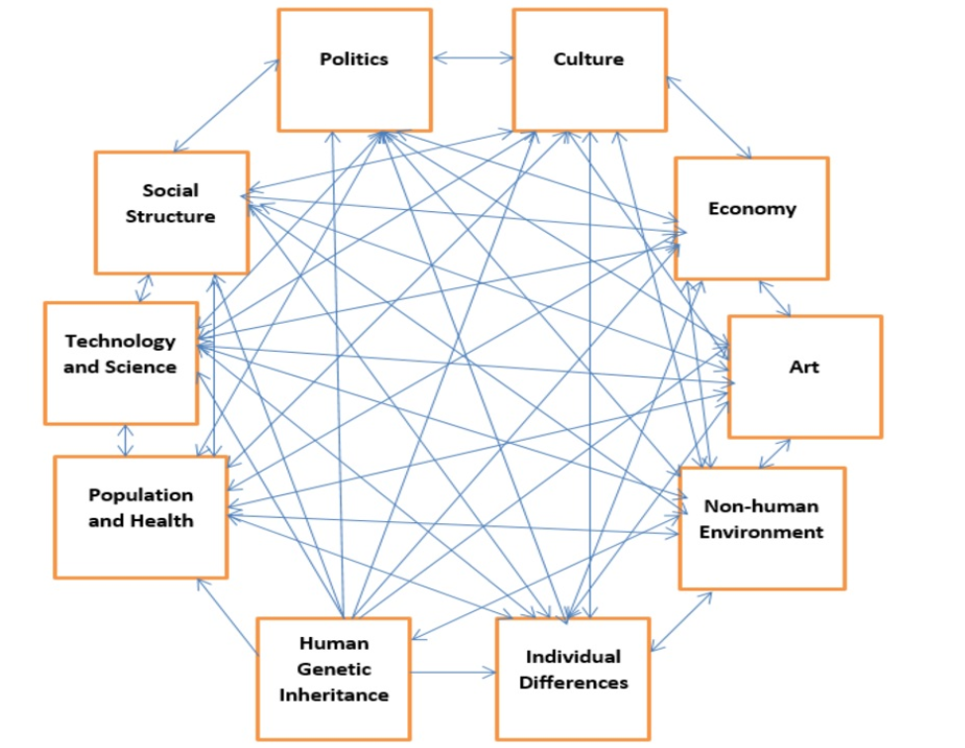
The Social Sciences did not divide the subject matter logically

Slide 12
Challenges in Collaborating with other Human Scientists
Different and often vague terminology
Differences in epistemological outlook
Quantitative versus qualitative
Research impact (pros and cons)

Slide 13
An Integrated Human Science
The Map of Human Science (and a recognition that all subsystems are open)
Integrative research within and among disciplines (That is, we need to devote much more effort to tying the pieces together.)
Recognition that all theories and methods are imperfect; have compensating strengths
Clarity in terminology and expression
Constructive postmodernism
Integrating the Human Sciences: Enhancing Cohesion and Progress across the Social Sciences and Humanities. London: Routledge. 2023.

Slide 14

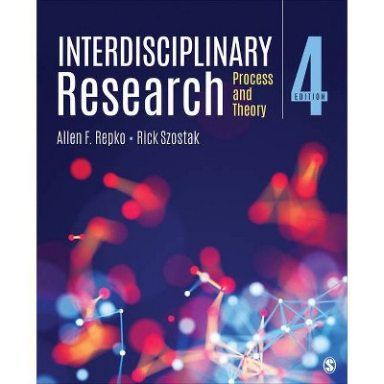

Some Recent Books (5th ed. in progress)

